Slide 1



CS3343 Software Engineering Practice
Group 2
CityU Cinema System
Presented by:
CHAN Ka Hong 57845658
FUNG Wing Ho 56755919
LAW Lok Hang 57842515
NG Ka Ho 56652261
WONG Tsz Kin 57847086

Slide 2
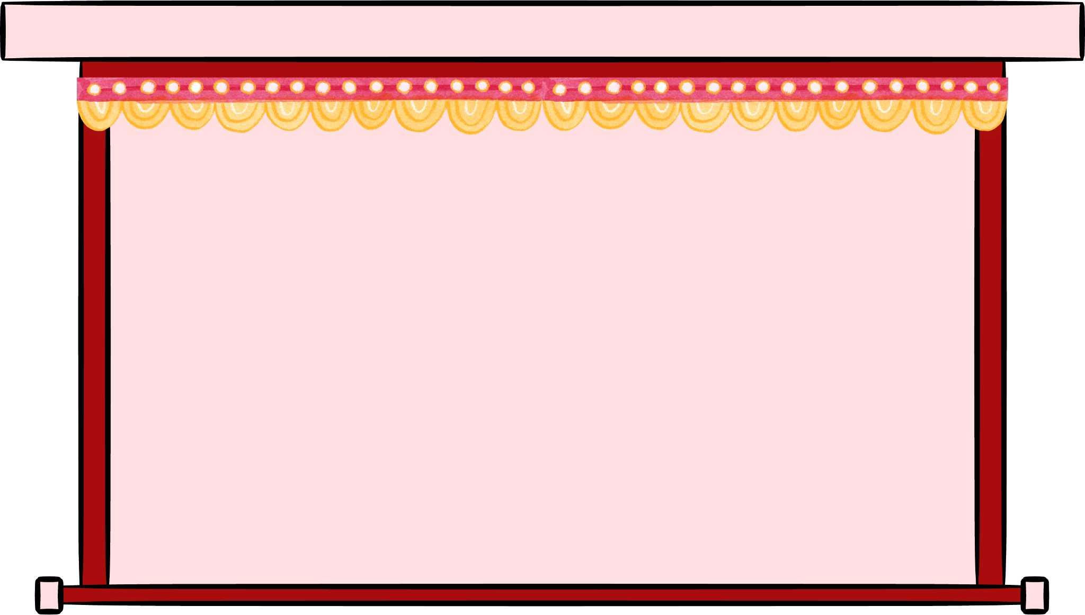
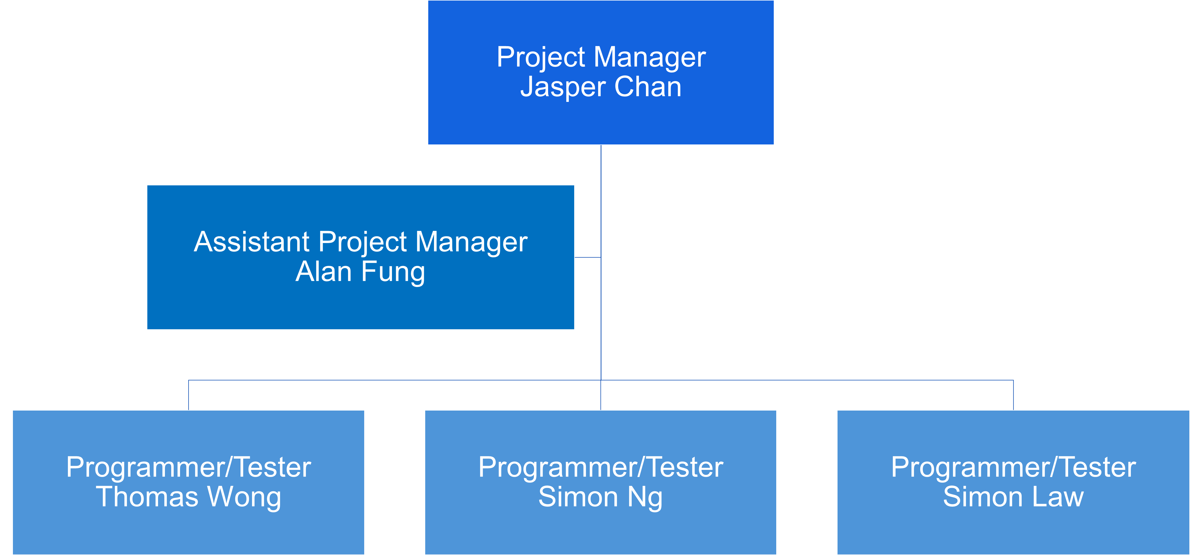

Project Team Organization
Management, Design, Development, Testing Support, Documentation
Design, Development, Testing, Documentation

Slide 3


Project Background
Watching movies at cinemas was once a popular leisure activity
Rise of online streaming platforms appears to have diminished the trend
Propose a movie ticketing and management system
Streamline online movie ticket ordering experience
Hopefully address the common challenges faced by general movie-goers and cinema managers
Provide an efficient and reliable platform for managing movie schedules and ticket reservations
Reignite people interests in watching movies in cinemas

Slide 4

Objectives
Streamline movie ticket booking services
E.g. list all scheduled movie sessions, select movie, book seats
Innovation: buy snacks/drinks in advance
User authentication and profiles
E.g. Log in & Registration, Personal information, payment records
Multiple payment methods
E.g. Alipay, Octopus, WeChat Pay, Credit card, etc.
Innovation: Strategic movie scheduling -> Profit-maximization vs Balanced

Slide 5
Scope & Requirements
 | Guest | Member | Admin
List Movies/ Movie Sessions | ✅ | ✅ | ✅
List Snacks/Drinks | ✅ | ✅ | ✅
Search Movies | ✅ | ✅ | ✅
Buy Movie Tickets, Snacks/Drinks |  | ✅
List Shopping Cart |  | ✅
Do Payment |  | ✅
List Payment Records |  | ✅
Personal Profile |  | ✅ | ✅
Reset Password |  | ✅ | ✅
List All/ Search Users |  |  | ✅
Add/ Delete Users |  |  | ✅
Add/ Schedule Movies |  |  | ✅
Add Snacks/Drinks |  |  | ✅
Logout |  | ✅ | ✅
Register | ✅
Login | ✅

Slide 6
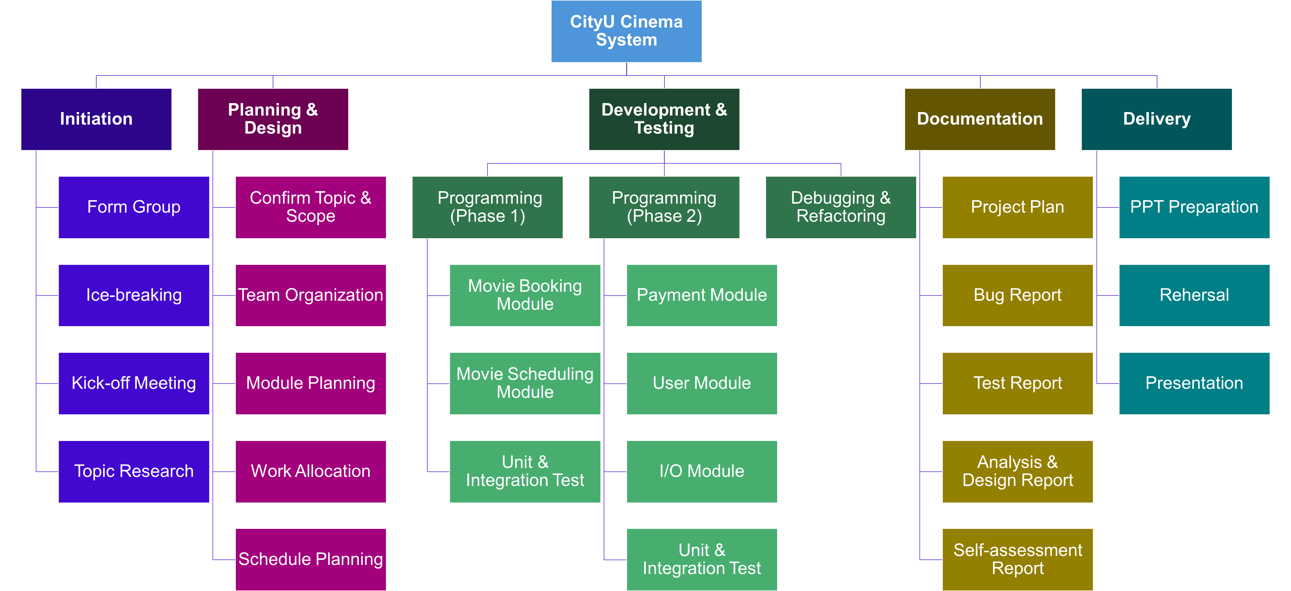
Work Breakdown Structure

Slide 7
Team Gantt Chart

Slide 8
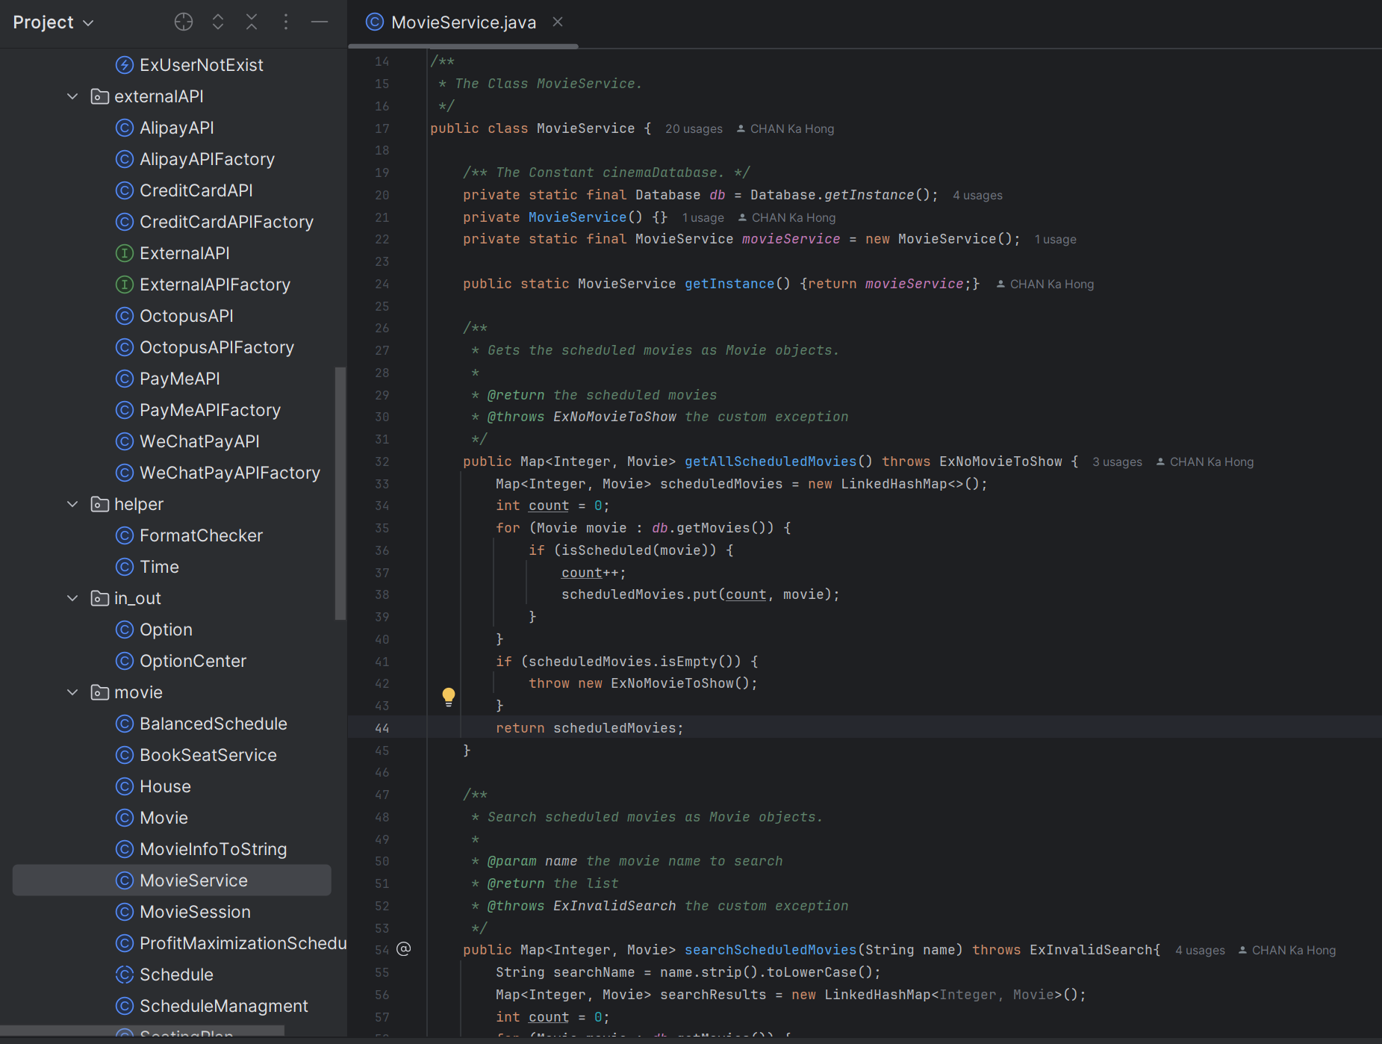
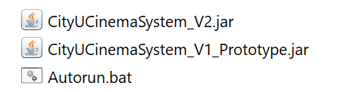
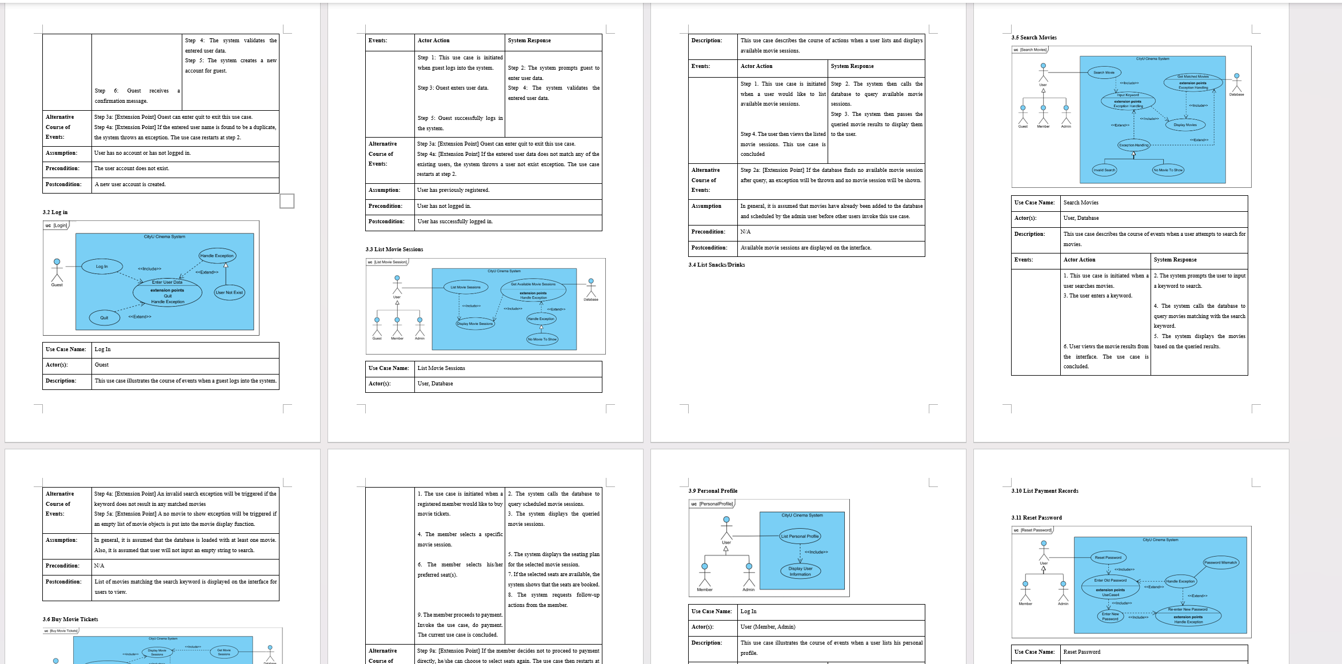
Progress & Constraints
Over 95% Completion (most objectives achieved)
2 releases so far
→ Final + Prototype (POF)
Well documented e.g. design, tests, bugs
Technical Constraint: No SQL database
Usability Constraint: Not multi-threaded, no timer function
Time Constraint: 3 months → ~ 1-month coding activities

Slide 9


Demo

Slide 10
Demo
All Options available for: 1. Guest 2. Member 3. Admin

Slide 11
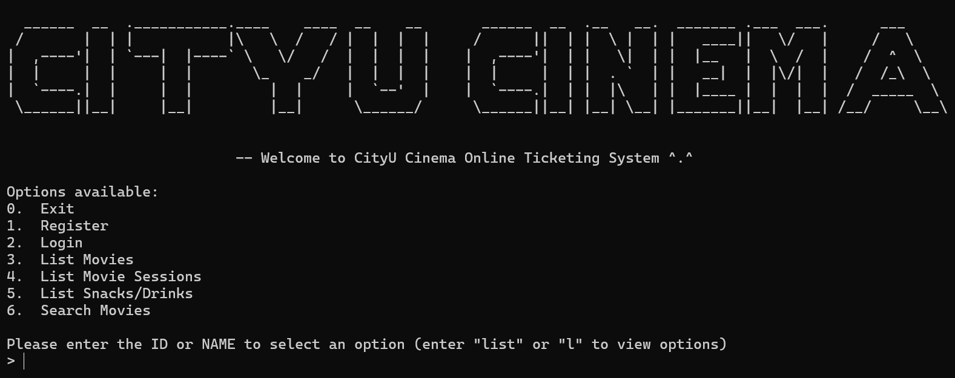
Demo - Guest
Start menu

Slide 12
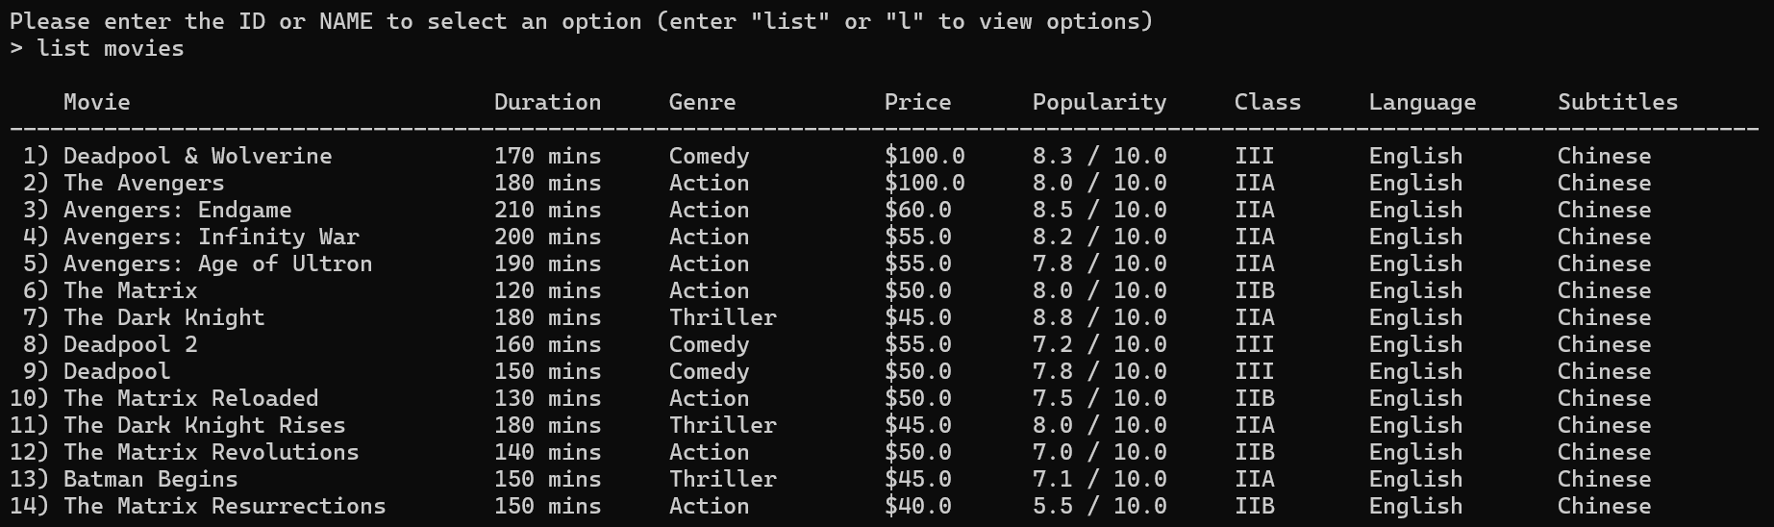
Demo - Guest
Option – 3. List Movies

Slide 13
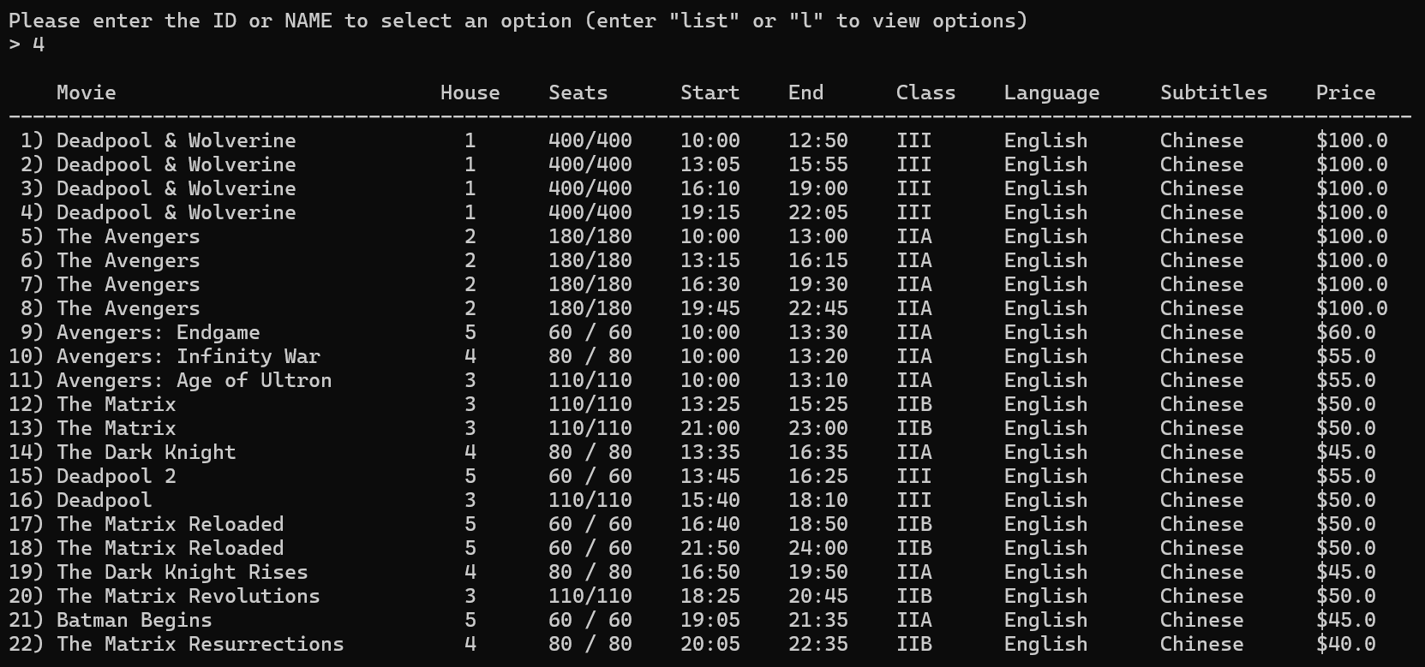
Demo - Guest
Option – 4. List Movie Sessions

Slide 14
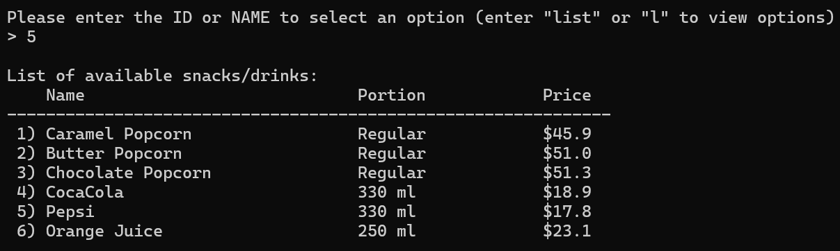
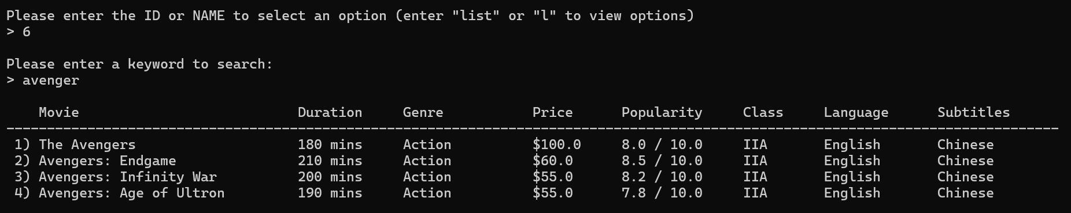
Demo - Guest
Option – 5. List Snacks/Drinks
Option – 6. Search Movies

Slide 15
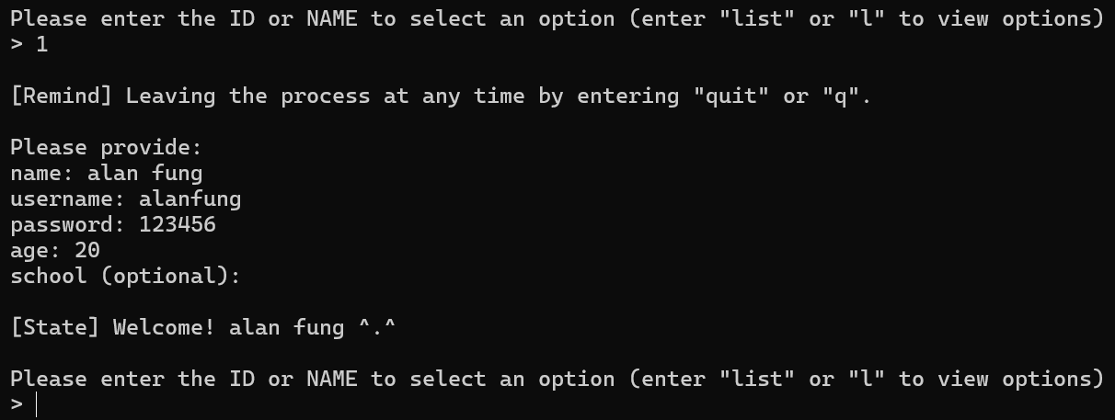
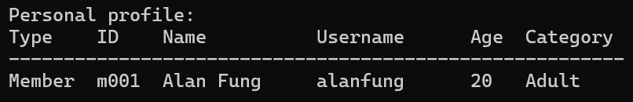
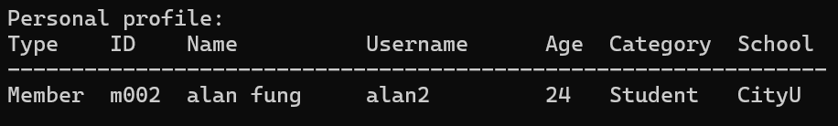
Demo - Guest
Option – 1. Register
Provide school or not

Slide 16
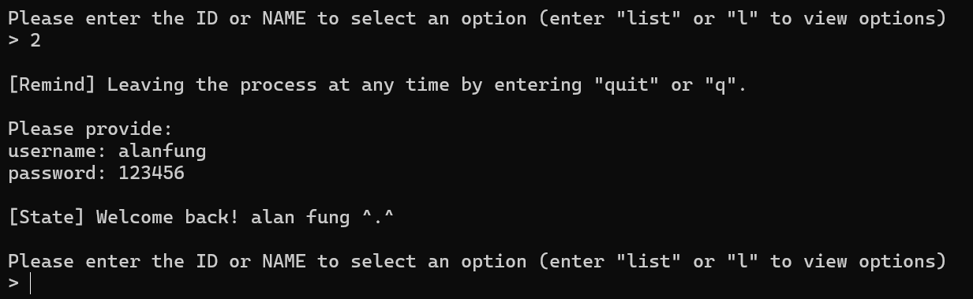
Demo - Guest
Option – 2. Login

Slide 17
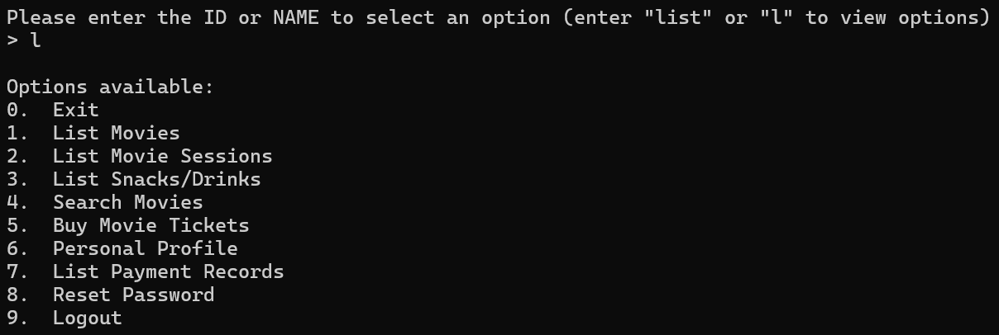
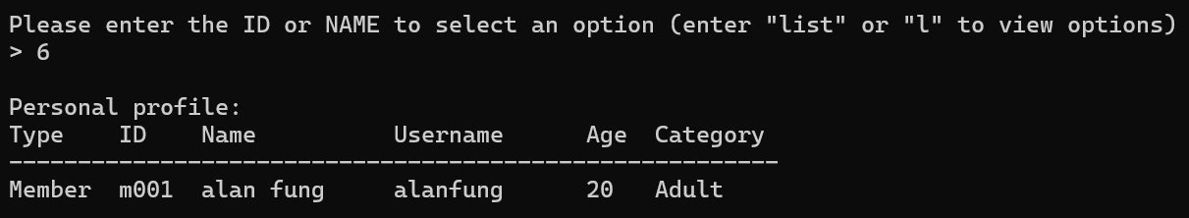
Demo - Member
Same options with Guest user
Option – 6. Personal Profile

Slide 18
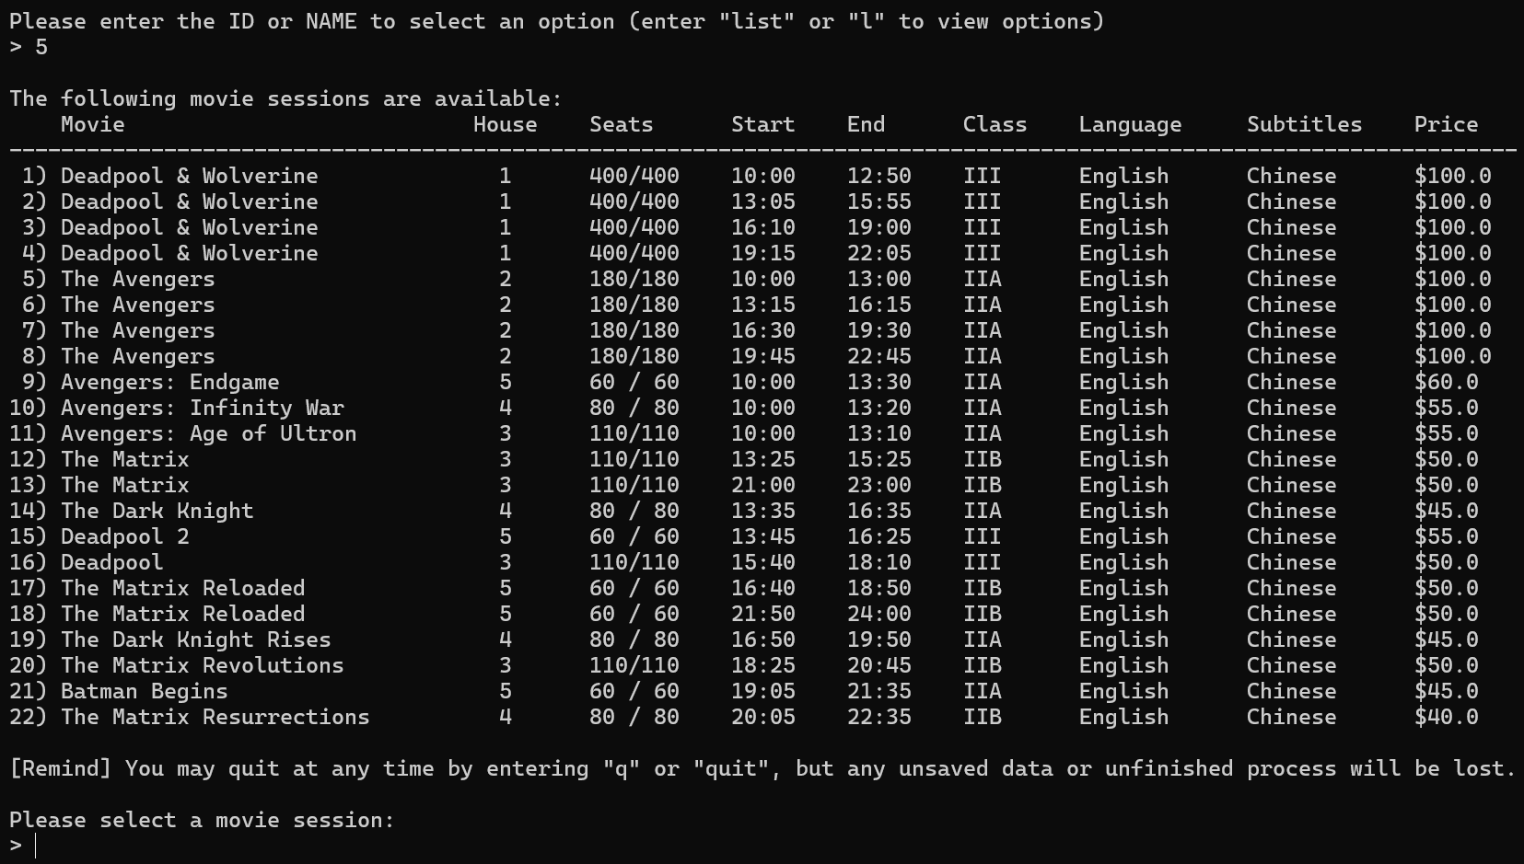
Demo - Member
Option – 5. Buy Movie Tickets (select movie session)

Slide 19
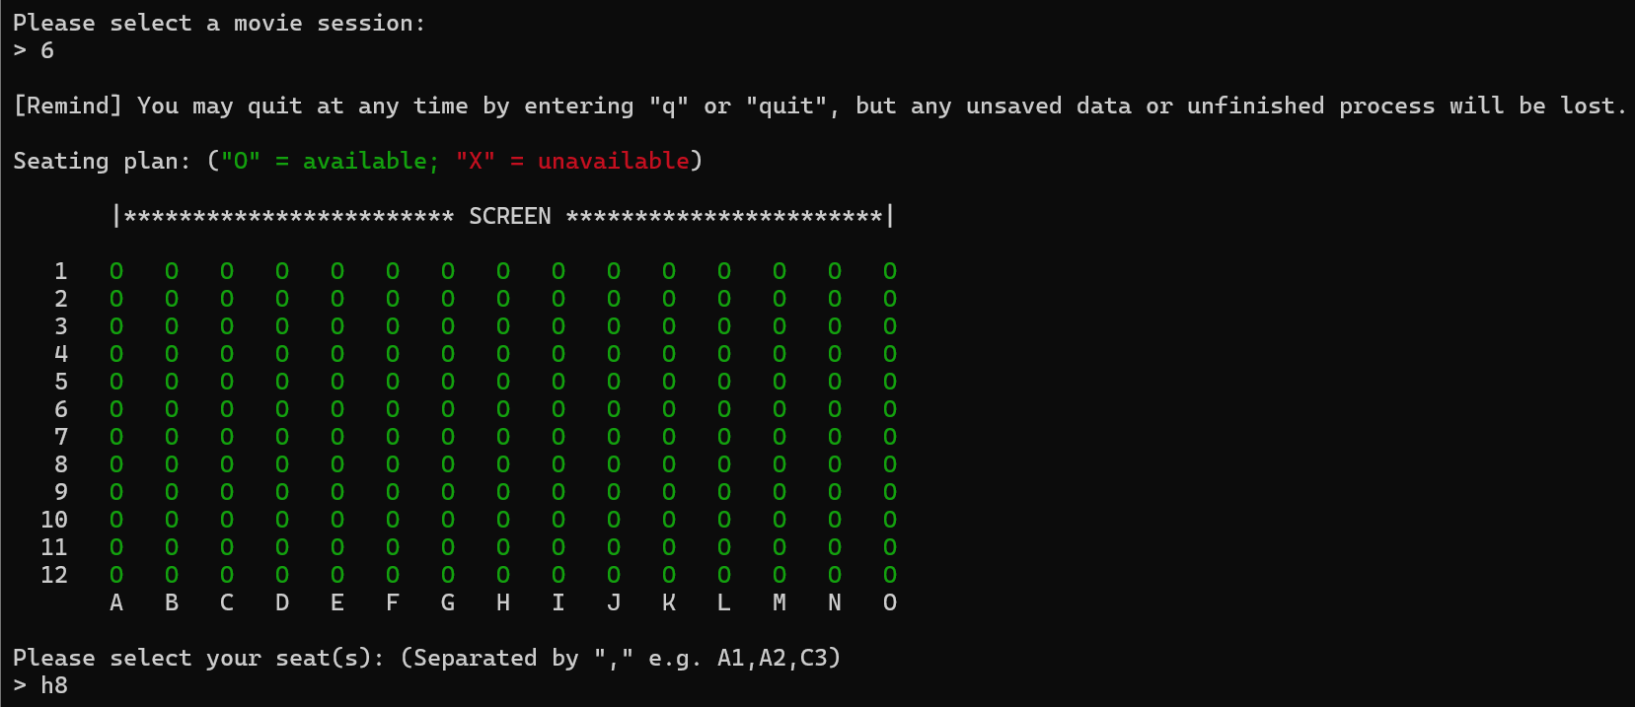
Demo - Member
Option – 5. Buy Movie Tickets (select seats)

Slide 20
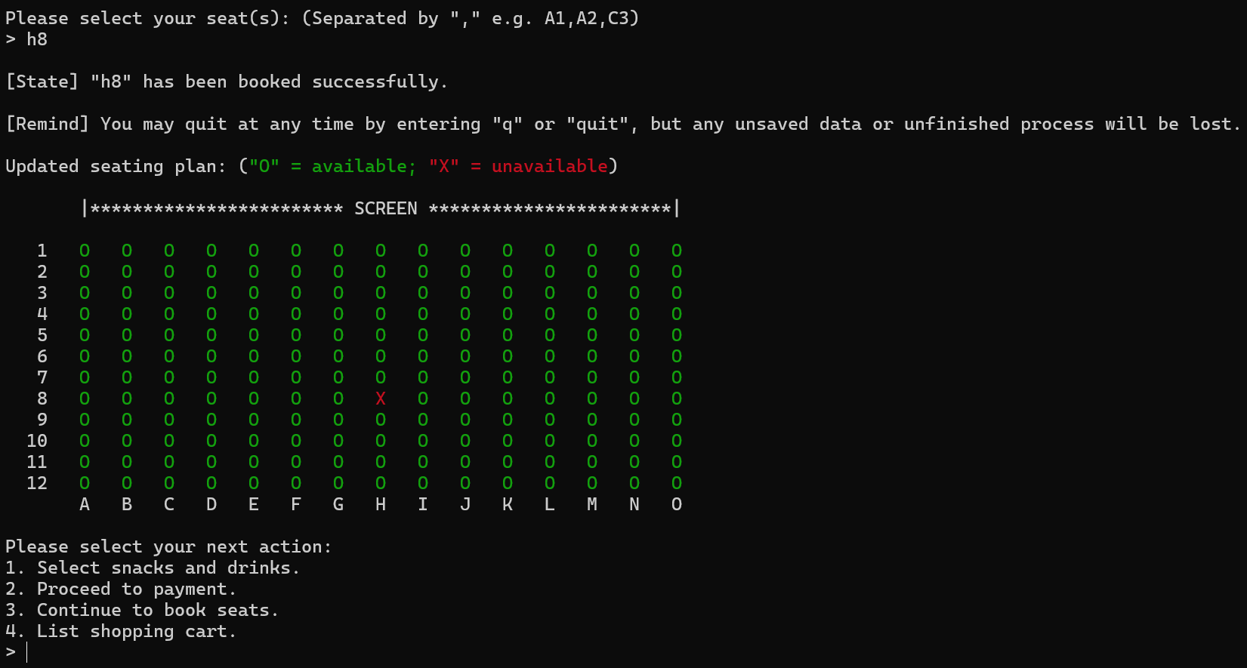
Demo - Member
Option – 5. Buy Movie Tickets (buy snacks/proceed to payment/book other seats/list shopping cart)

Slide 21
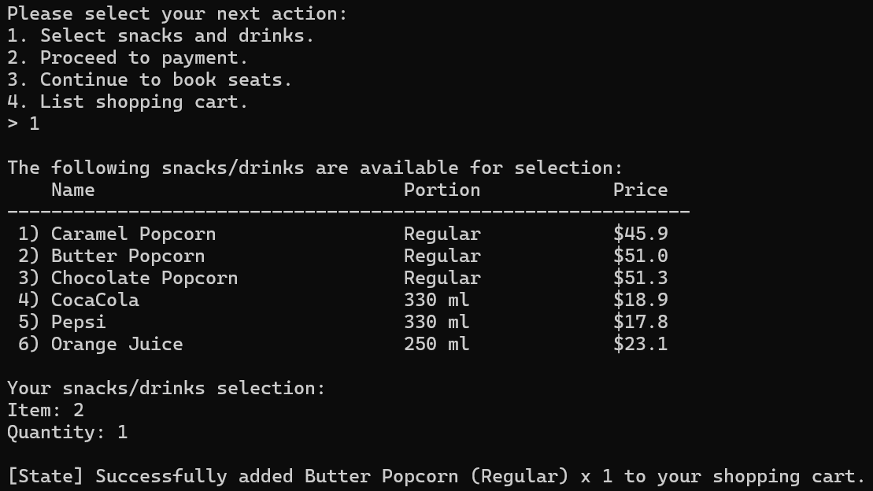
Demo - Member
Option – 5. Buy Movie Tickets (buy snacks)

Slide 22
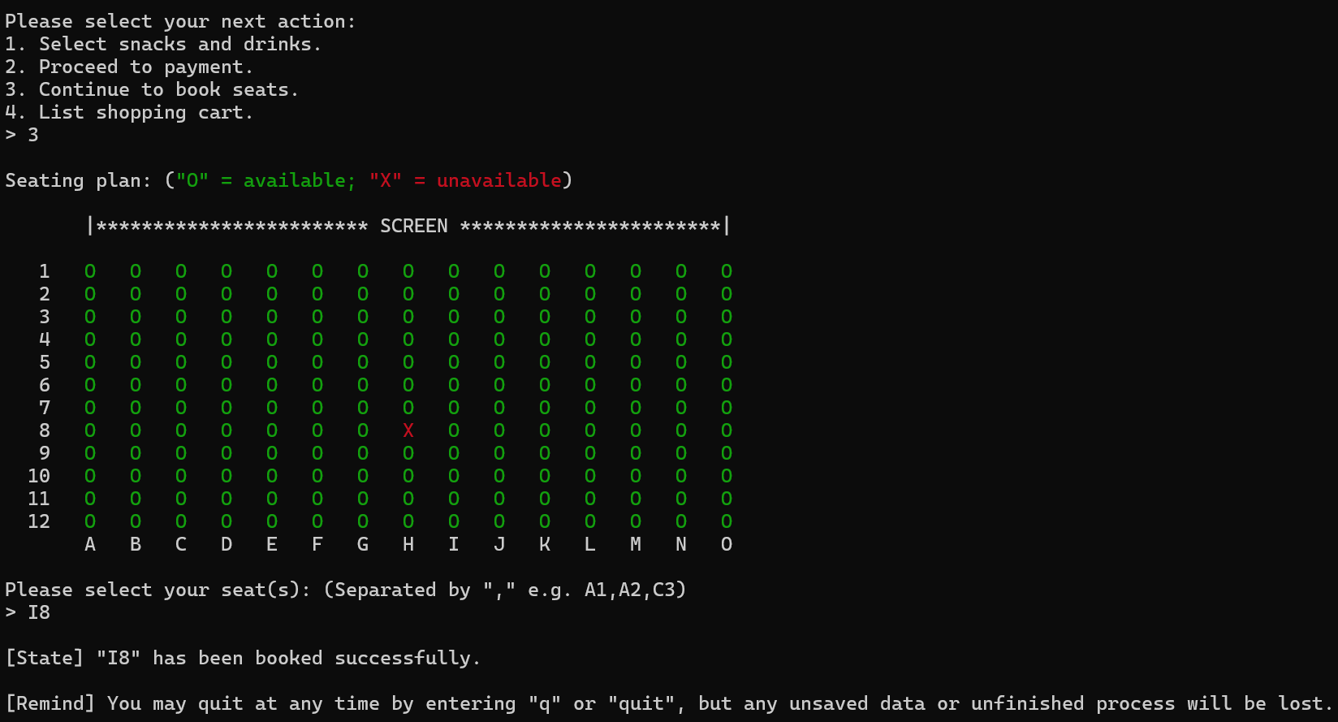
Demo - Member
Option – 5. Buy Movie Tickets (book other seats)

Slide 23
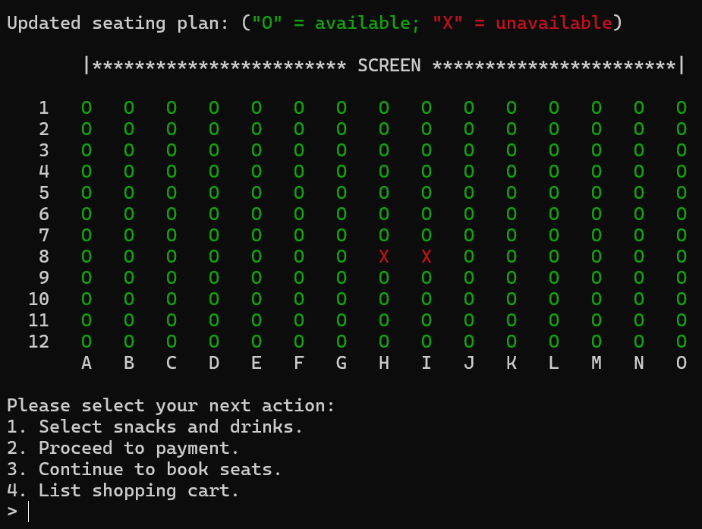
Demo - Member
Option – 5. Buy Movie Tickets (book other seats)

Slide 24
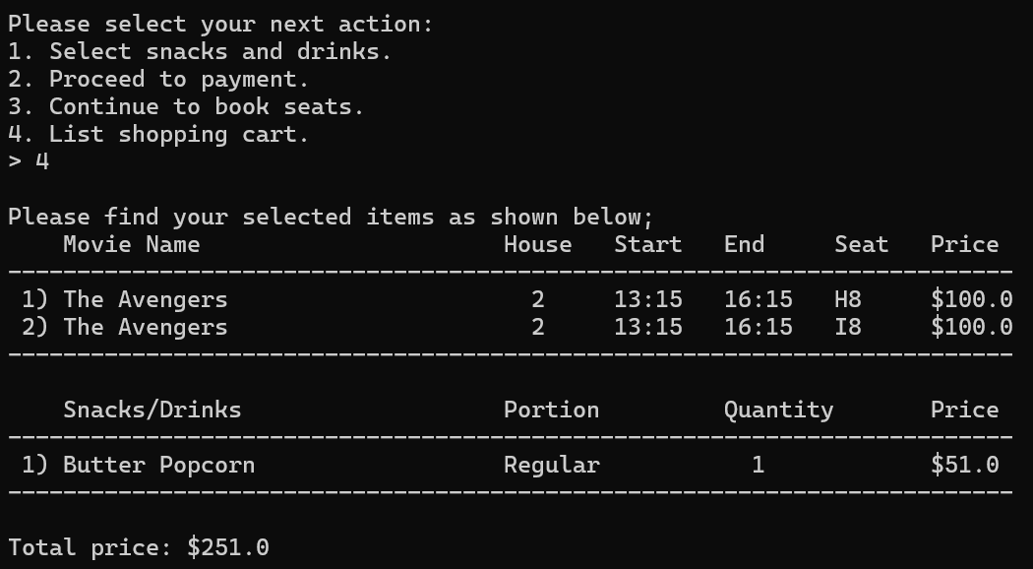
Demo - Member
Option – 5. Buy Movie Tickets (list shopping cart)

Slide 25
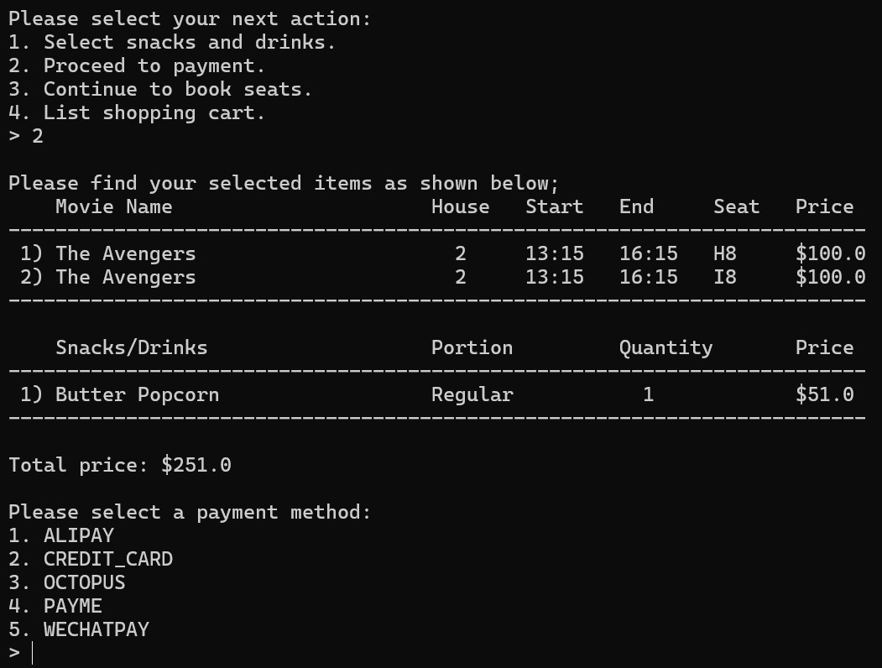
Demo - Member
Option – 5. Buy Movie Tickets (proceed to payment)

Slide 26
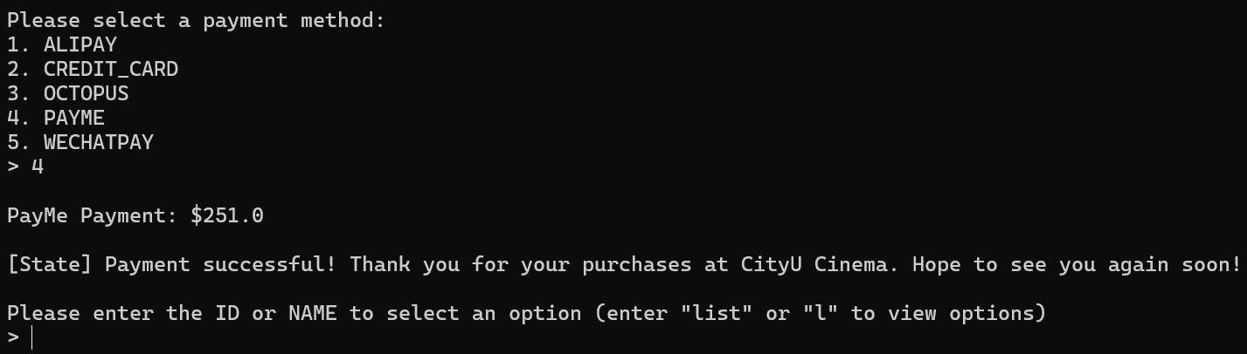
Demo - Member
Option – 5. Buy Movie Tickets (proceed to payment)

Slide 27
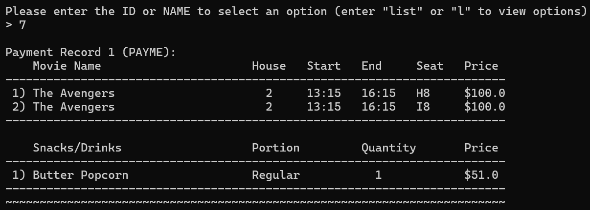
Demo - Member
Option – 7. List Payment Record

Slide 28
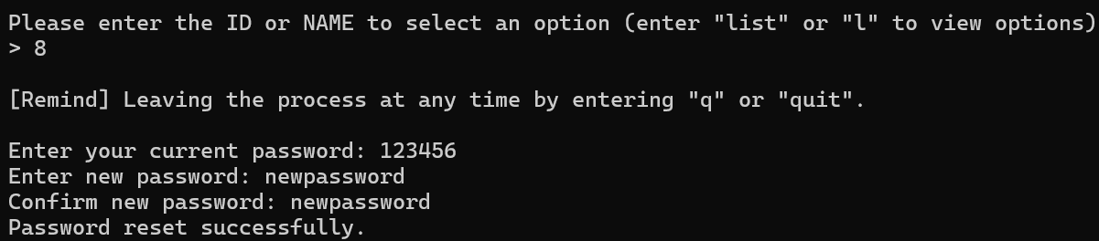
Demo - Member
Option – 8. Reset Password

Slide 29
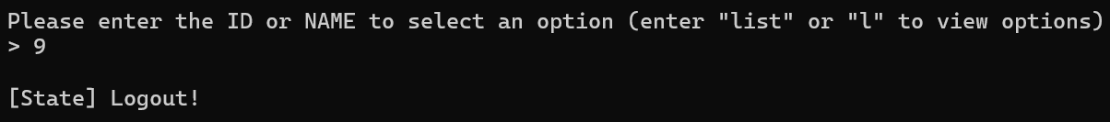
Demo - Member
Option – 9. Logout

Slide 30
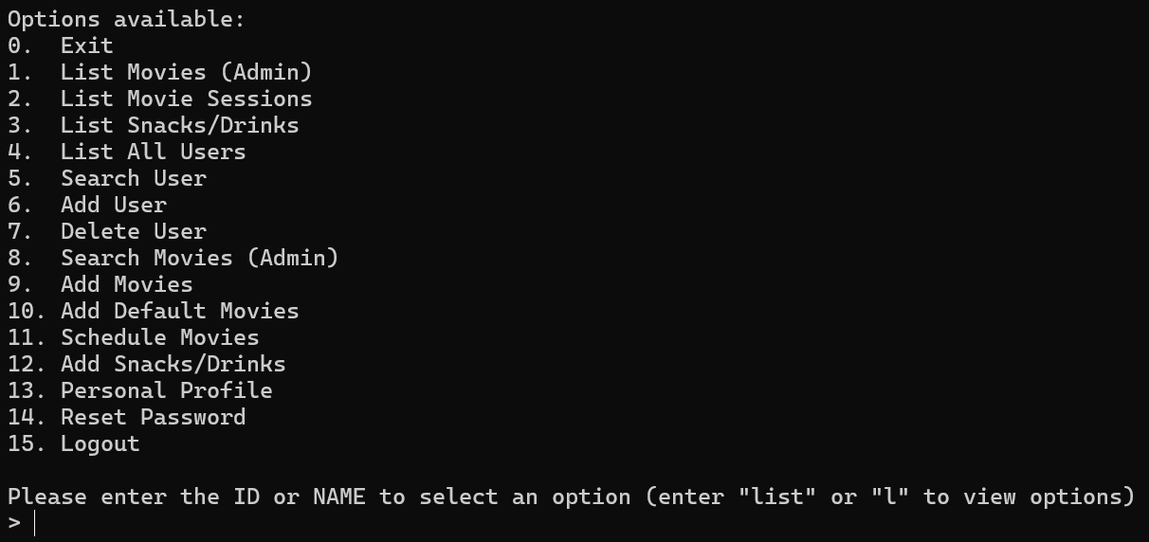
Demo - Admin
Same options with Guest/Member user

Slide 31
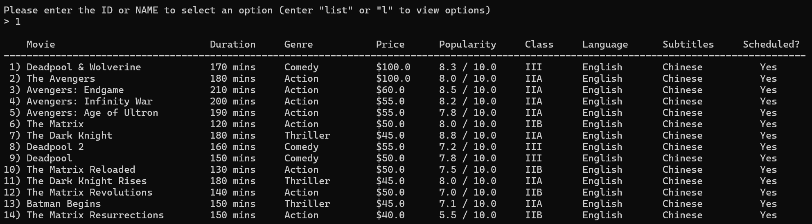
Demo - Admin
Options – 1. List Movies (Admin)

Slide 32
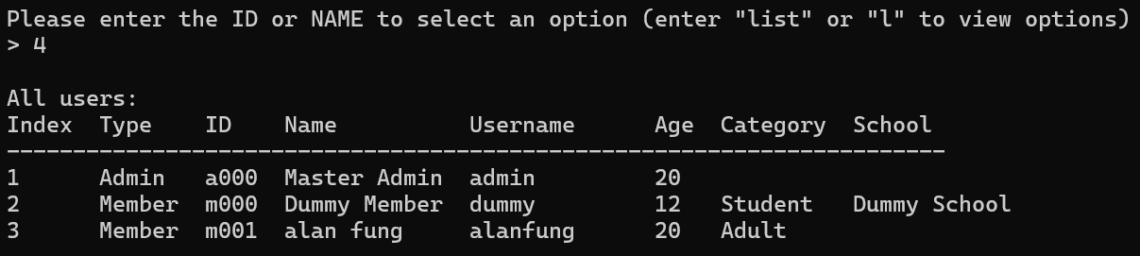
Demo - Admin
Options – 4. List All Users

Slide 33
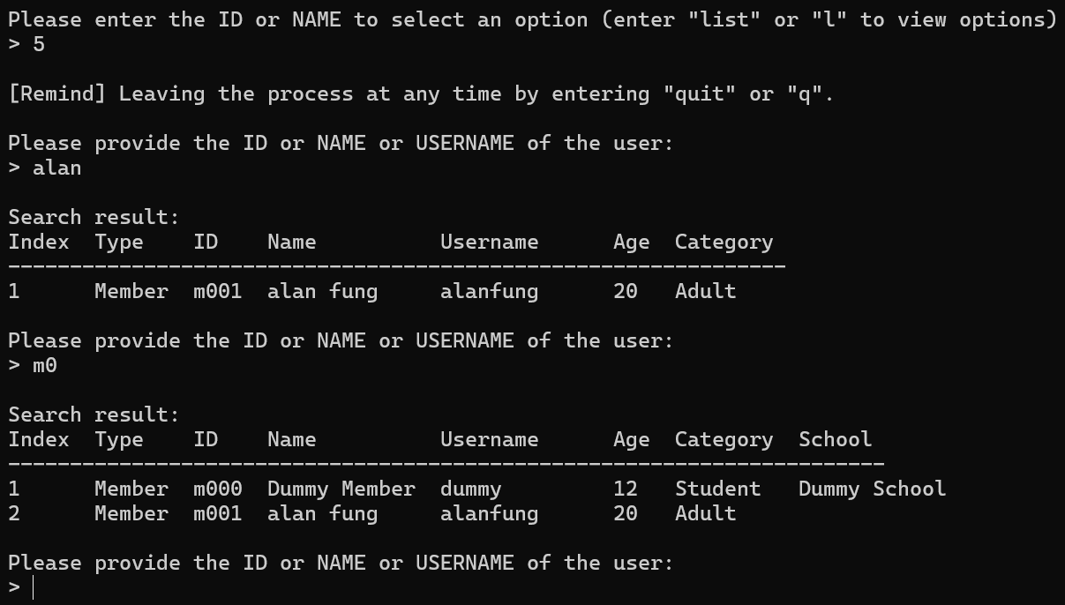
Demo - Admin
Options – 5. Search User

Slide 34
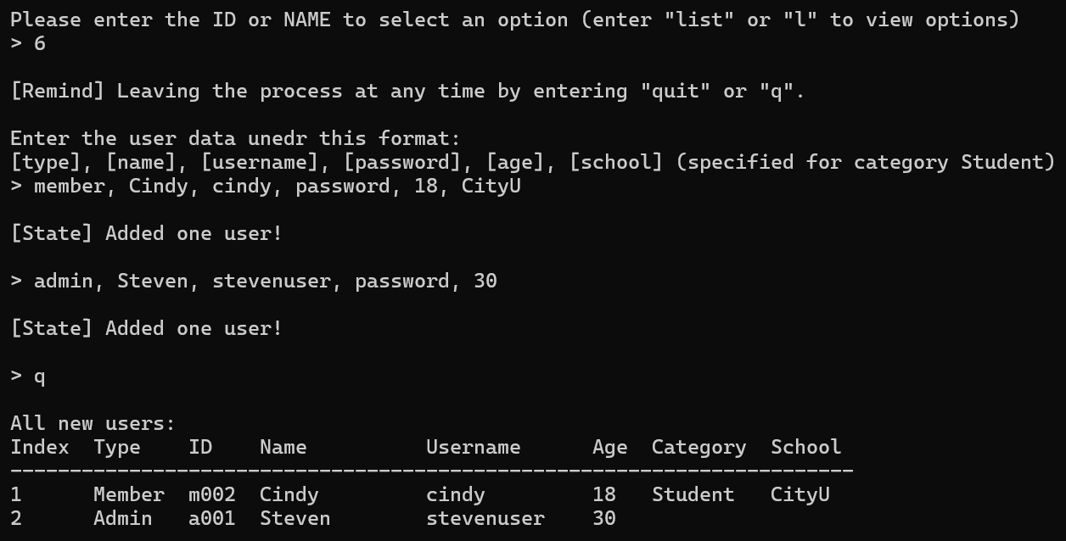
Demo - Admin
Options – 6. Add User

Slide 35
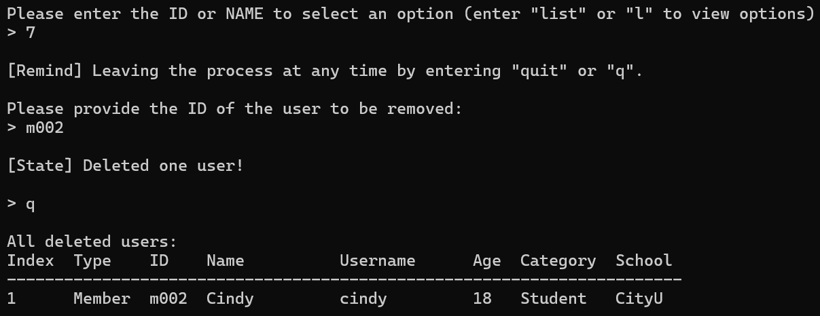
Demo - Admin
Options – 7. Delete User

Slide 36
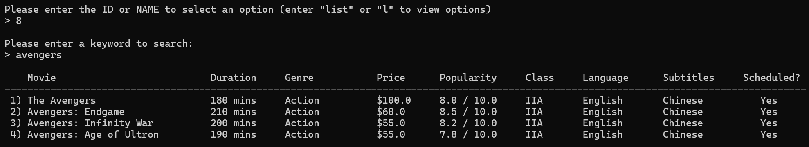
Demo - Admin
Options – 8. Search Movies (Admin)

Slide 37
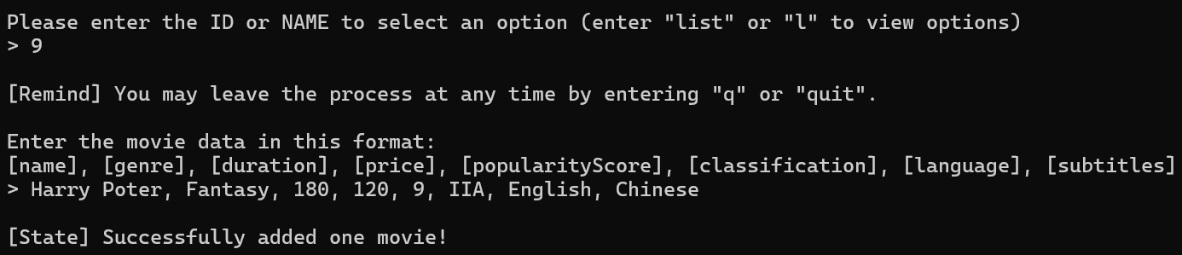
Demo - Admin
Options – 9. Add Movies

Slide 38
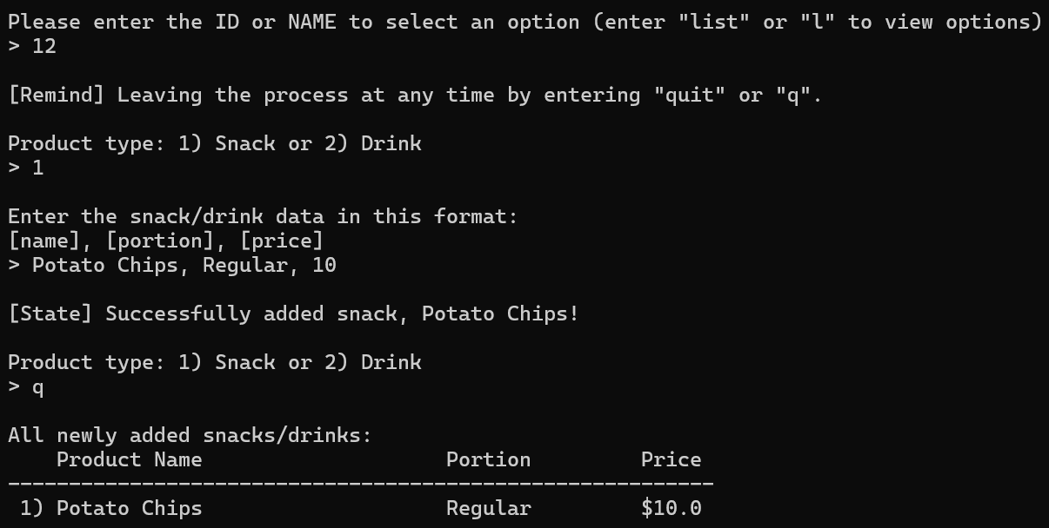
Demo - Admin
Options – 12. Add Snacks/Drinks

Slide 39
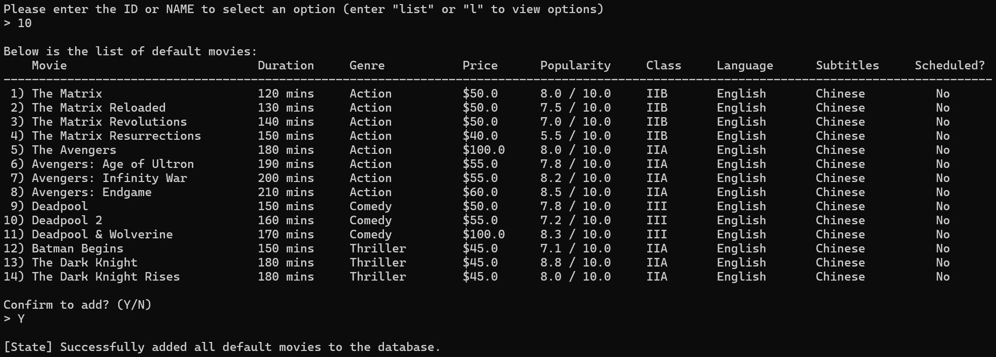
Demo - Admin
Options – 10. Add Default Movies

Slide 40
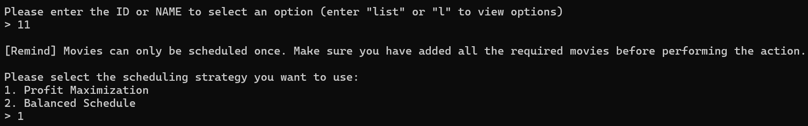
Demo - Admin
Options – 11. Schedule Movies

Slide 41
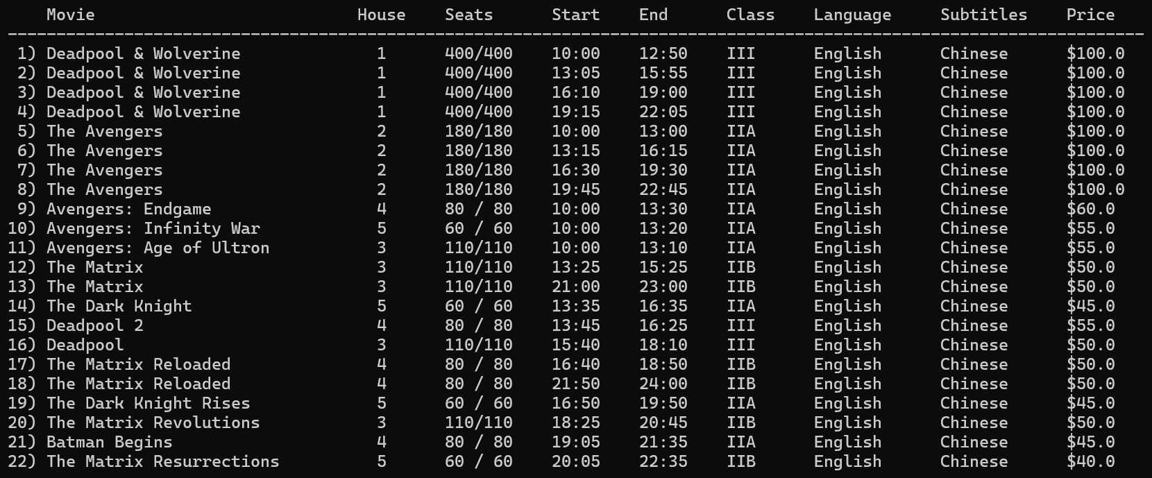
Demo - Admin
Options – 11. Schedule Movies (profit maximization)

Slide 42
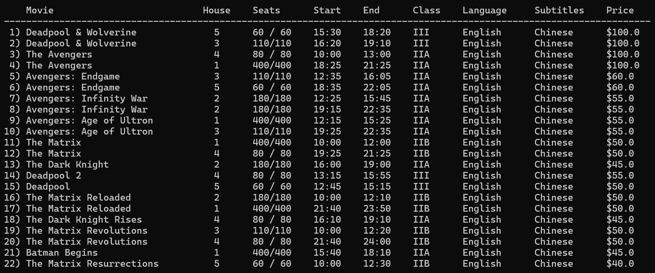
Demo - Admin
Options – 11. Schedule Movies (balanced schedule)

Slide 43
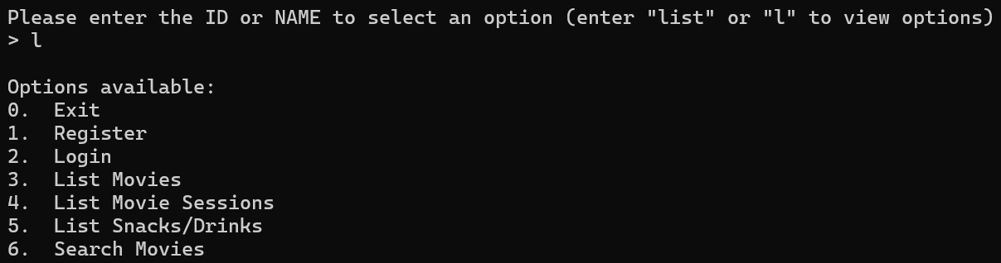
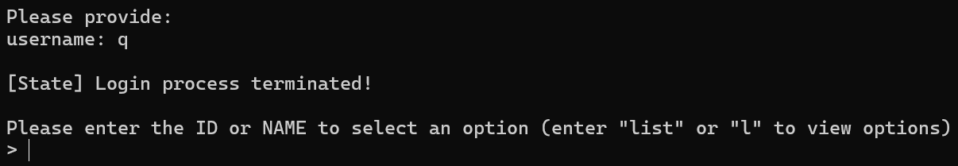
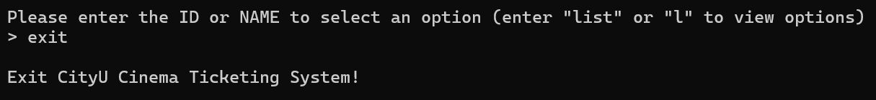
Demo – Guest/Member/Admin
“list” OR “l” to view options
“quit” OR “q” to quit a process
“exit” OR “0” to exit the system

Slide 44
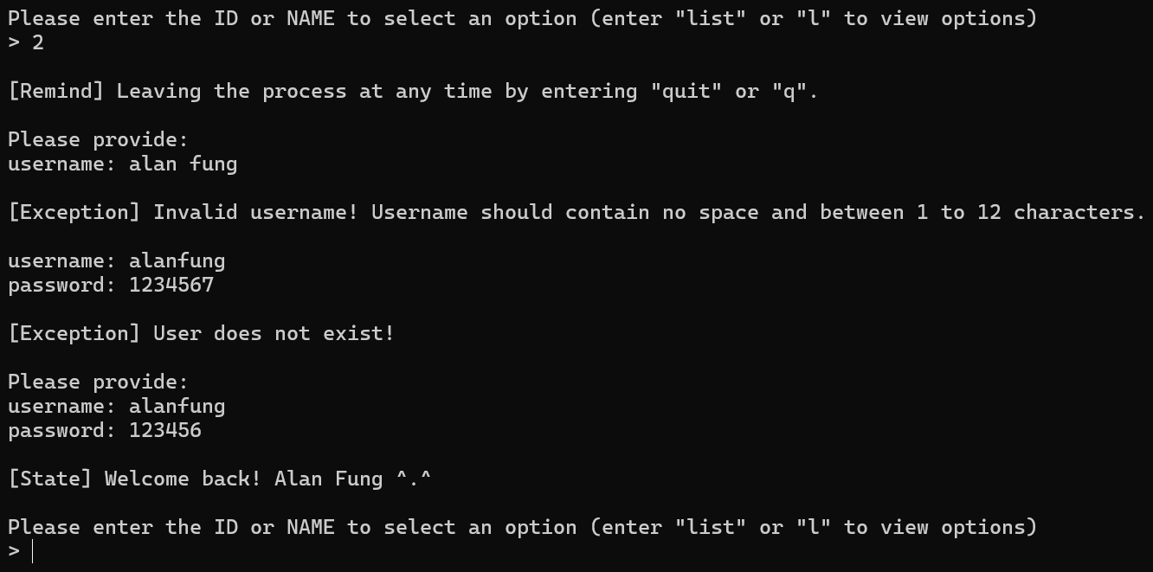
Demo – Guest/Member/Admin
1st level exception handling (format checking)
2nd level exception handling (verify with existing data)

Slide 45
System Design

Slide 46
System Design
Class Diagram (Top Level)
Design Principle 1. Single Responsibility Rule 2. Open-close principle 3. Liskov Substitution principle 4. Dependency Inversion Principle
Design Pattern 1. Singleton 2. Strategy 3. Factory method

Slide 47
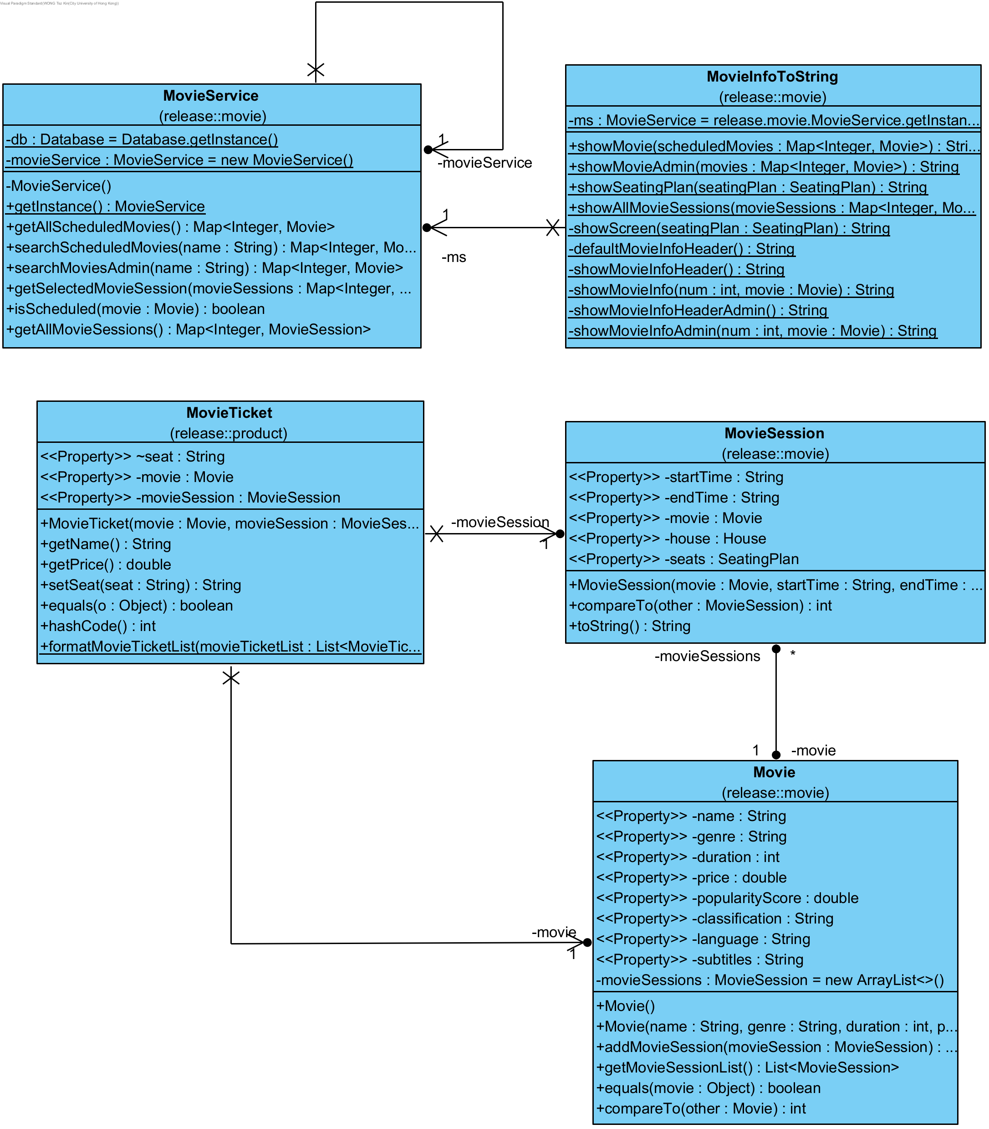
Single Responsibility Rule
Each class should only be responsible for one responsibility

Slide 48
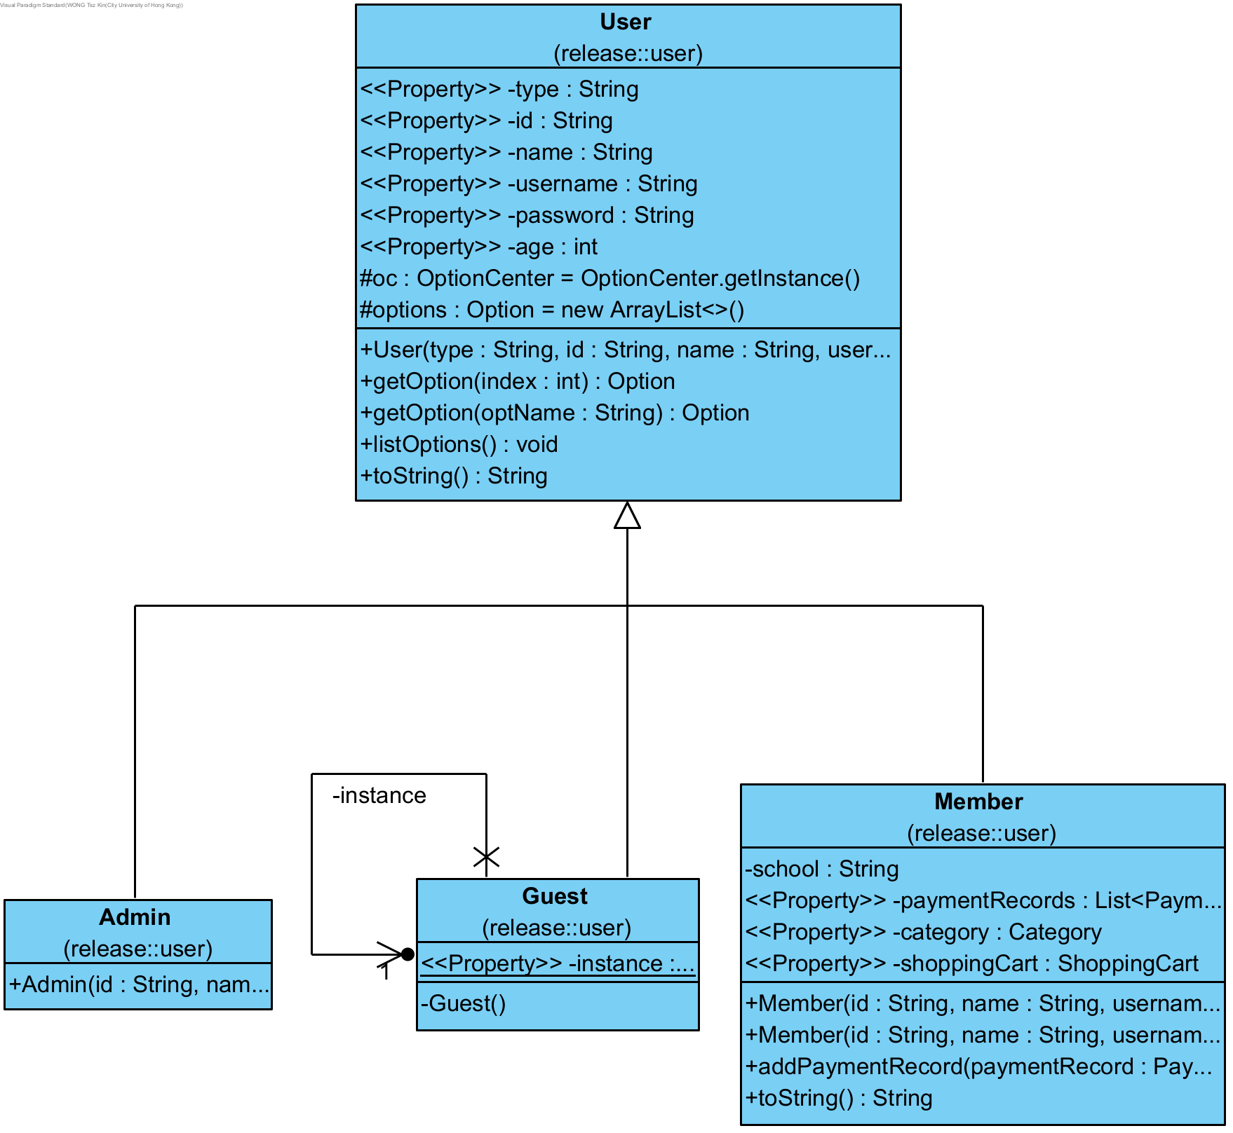
Open-close principle
Classes’ behaviour can be extended without modifying the existing code
All types of users are extended from the User class
If a new user type is added, it can be done by simply extending the User class without modifying the existing code

Slide 49
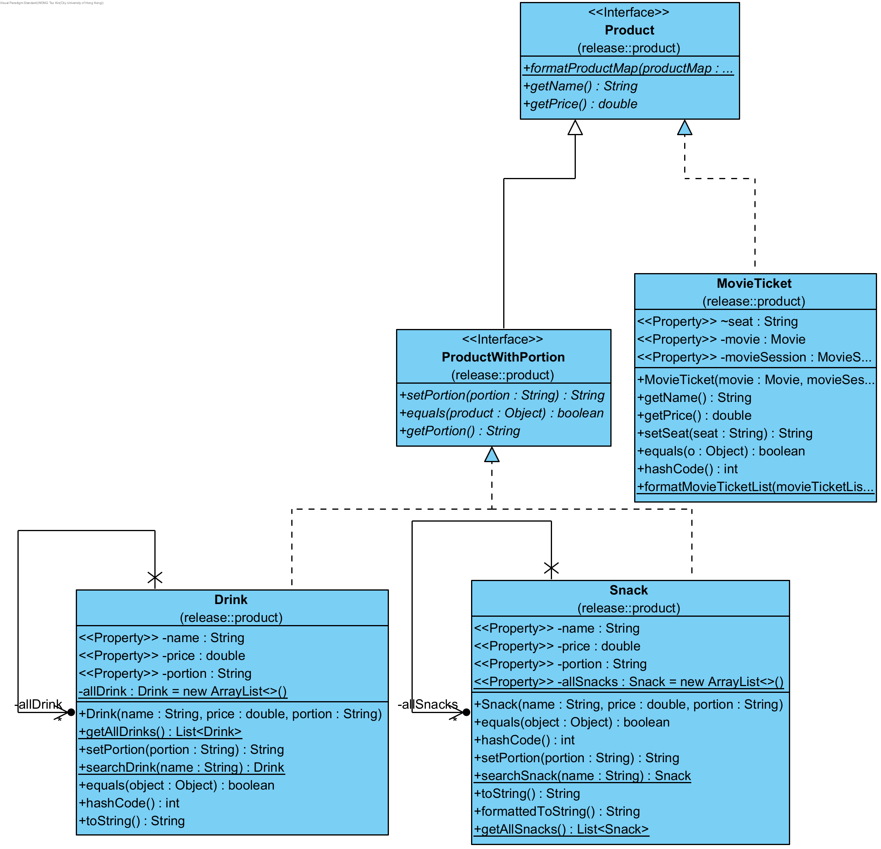
Liskov Substitution principle
The subclass can be completely substitutable for their parent class
Products are separated by two interfaces Product and ProductWithPotion
Can be completely substitutable to all products and extends for new products in the future

Slide 50
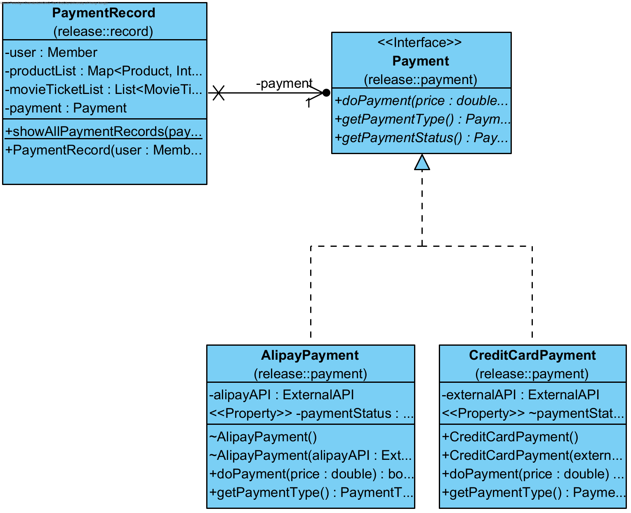
Dependency Inversion Principle
High-level modules should depend on abstractions instead of low-level modules

Slide 51

Singleton Design Pattern
Ensure a class has only one instance
Use it for multiple class
E.g. database

Slide 52

Strategy Design Pattern
Allows an object to change its behaviour by changing the algorithm used at runtime
Use to choose different methods for scheduling movies

Slide 53

Factory Method Design Pattern
Provides an interface for creating an object and allows the subclass to decide the class to create
Used in Payment for creating different payment objects

Slide 54

Sequence Diagram - Register

Slide 57

Sequence Diagram - Buy Movie Tickets (select movie session)

Slide 58
The content before and after this line is not continue

Slide 59


Testing Process
White Box Testing: most of the modules
Black Box Testing: command module (system test all the different command to check whether our program can meet all the use case scenarios)

Slide 60

Modules Hierarchy
Testing Approach: Bottom-up

Slide 61

Modules Hierarchy
Testing Approach: Bottom-up
1) Unit Test: record, exception,
externalAPI, helper, in_out, database

Slide 62

Modules Hierarchy
Testing Approach: Bottom-up
1) Unit Test: record, exception,
externalAPI, helper, in_out, database
2) Integration Test:
Movie + database

Slide 63
Modules Hierarchy
Testing Approach: Bottom-up
1) Unit Test: record, exception,
externalAPI, helper, in_out, database
2) Integration Test:
Movie + database
product + movie + database

Slide 64
Modules Hierarchy
Testing Approach: Bottom-up
1) Unit Test: record, exception,
externalAPI, helper, in_out, database
2) Integration Test:
Movie + database
product + movie + database
shoppingCart + product + movie + database

Slide 65
Modules Hierarchy
Testing Approach: Bottom-up
1) Unit Test: record, exception,
externalAPI, helper, in_out, database
2) Integration Test:
Movie + database
product + movie + database
shoppingCart + product + movie + database
user + in_out + shoppingCart + product + movie + database

Slide 66

Modules Hierarchy
Testing Approach: Bottom-up
1) Unit Test: record, exception,
externalAPI, helper, in_out, database
2) Integration Test:
Movie + database
product + movie + database
shoppingCart + product + movie + database
user + in_out + shoppingCart + product + movie + database
command + user + helper + in_out + shoppingCart + product + movie + database
payment + externalAPI

Slide 67
Modules Hierarchy
Testing Approach: Bottom-up
1) Unit Test: record, exception,
externalAPI, helper, in_out, database
2) Integration Test:
Movie + database
product + movie + database
shoppingCart + product + movie + database
user + in_out + shoppingCart + product + movie + database
command + user + helper + in_out + shoppingCart + product + movie + database
payment + externalAPI
3) System Test: whole system

Slide 68

Test Coverage
Coverage Strategies: Statement Coverage
Number of test cases employed: 324
Overall test coverage: 79.1 %

Slide 69


Essential Tools for Successful Project Development

Slide 70






Essential Tools for Successful Project Development
IDEs:
IntelliJ IDEA
Eclipse
VS code
Other tools:
Visual paradigm
BlueJ
GitHub

Slide 71

Thank You!
Q&A Time

